Slide 1
Data Mining:
Concepts and Techniques
(3^{rd ed.)}
^{— Chapter 10 —}
Jiawei Han, Micheline Kamber, and Jian Pei
University of Illinois at Urbana-Champaign &
Simon Fraser University
©2013 Han, Kamber & Pei. All rights reserved.
<number>
Notes:
<number>

Slide 2
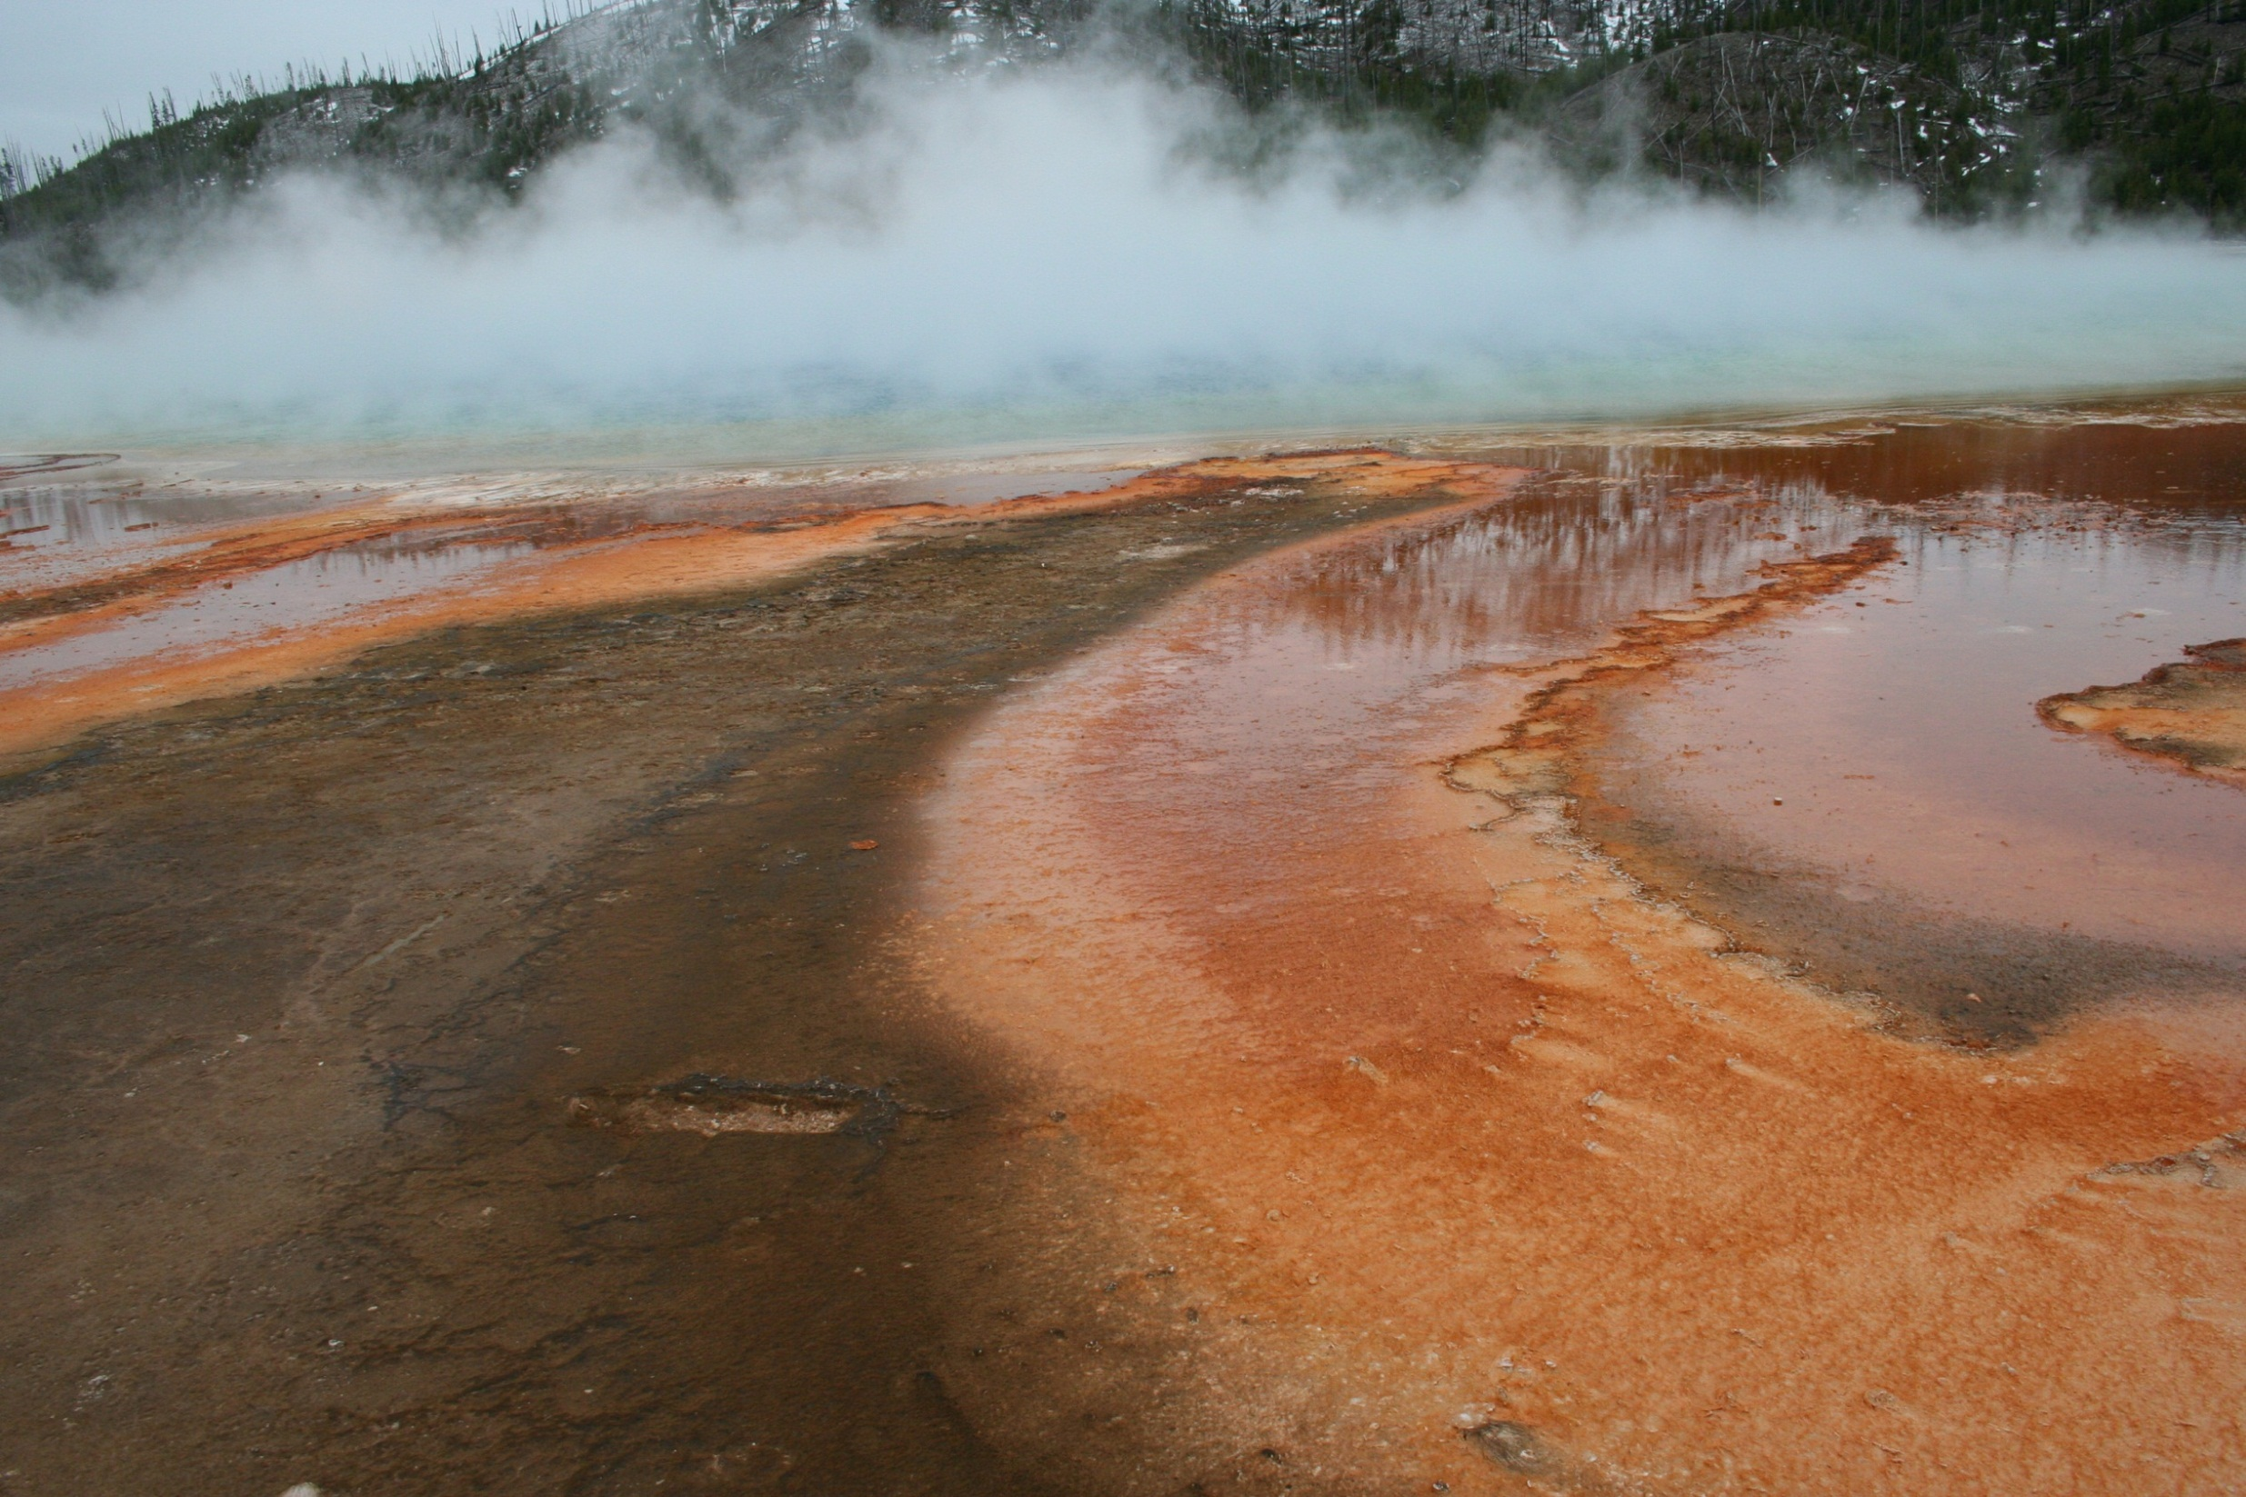

Slide 3
Chapter 10. Cluster Analysis: Basic Concepts and Methods
Cluster Analysis: Basic Concepts
Partitioning Methods
Hierarchical Methods
Density-Based Methods
Grid-Based Methods
Evaluation of Clustering
Summary
<number>
<number>
Notes:
<number>

Slide 4
What is Cluster Analysis?
Cluster: A collection of data objects
  similar (or related) to one another within the same group
  dissimilar (or unrelated) to the objects in other groups
Cluster analysis (or clustering, data segmentation, …)
  Finding similarities between data according to the characteristics found in the data and grouping similar data objects into clusters
Unsupervised learning: no predefined classes (i.e., learning by observations vs. learning by examples: supervised)
Typical applications
  As a stand-alone tool to get insight into data distribution
  As a preprocessing step for other algorithms
<number>
Notes:
<number>

Slide 5
Applications of Cluster Analysis
Data reduction
  Summarization: Preprocessing for regression, PCA, classification, and association analysis
  Compression: Image processing: vector quantization
Hypothesis generation and testing
Prediction based on groups
  Cluster & find characteristics/patterns for each group
Finding K-nearest Neighbors
  Localizing search to one or a small number of clusters
Outlier detection: Outliers are often viewed as those “far away” from any cluster
<number>

Slide 6
Clustering: Application Examples
Biology: taxonomy of living things: kingdom, phylum, class, order, family, genus and species
Information retrieval: document clustering
Land use: Identification of areas of similar land use in an earth observation database
Marketing: Help marketers discover distinct groups in their customer bases, and then use this knowledge to develop targeted marketing programs
City-planning: Identifying groups of houses according to their house type, value, and geographical location
Earth-quake studies: Observed earth quake epicenters should be clustered along continent faults
Climate: understanding earth climate, find patterns of atmospheric and ocean
Economic Science: market resarch
<number>
Notes:
<number>

Slide 7
Basic Steps to Develop a Clustering Task
Feature selection
  Select info concerning the task of interest
  Minimal information redundancy
Proximity measure
  Similarity of two feature vectors
Clustering criterion
  Expressed via a cost function or some rules
Clustering algorithms
  Choice of algorithms
Validation of the results
  Validation test (also, clustering tendency test)
Interpretation of the results
  Integration with applications
<number>

Slide 8
Quality: What Is Good Clustering?
A good clustering method will produce high quality clusters
  high intra-class similarity: cohesive within clusters
  low inter-class similarity: distinctive between clusters
The quality of a clustering method depends on
  the similarity measure used by the method
  its implementation, and
  Its ability to discover some or all of the hidden patterns
<number>
Notes:
<number>

Slide 9
Measure the Quality of Clustering
Dissimilarity/Similarity metric
  Similarity is expressed in terms of a distance function, typically metric: d(i, j)
  The definitions of distance functions are usually rather different for interval-scaled, boolean, categorical, ordinal ratio, and vector variables
  Weights should be associated with different variables based on applications and data semantics
Quality of clustering:
  There is usually a separate “quality” function that measures the “goodness” of a cluster.
  It is hard to define “similar enough” or “good enough”
    The answer is typically highly subjective
<number>
Notes:
<number>

Slide 10
Considerations for Cluster Analysis
Partitioning criteria
  Single level vs. hierarchical partitioning (often, multi-level hierarchical partitioning is desirable)
Separation of clusters
  Exclusive (e.g., one customer belongs to only one region) vs. non-exclusive (e.g., one document may belong to more than one class)
Similarity measure
  Distance-based (e.g., Euclidian, road network, vector) vs. connectivity-based (e.g., density or contiguity)
Clustering space
  Full space (often when low dimensional) vs. subspaces (often in high-dimensional clustering)
<number>

Slide 11
Requirements and Challenges
Scalability
  Clustering all the data instead of only on samples
Ability to deal with different types of attributes
  Numerical, binary, categorical, ordinal, linked, and mixture of these
Constraint-based clustering
    User may give inputs on constraints
    Use domain knowledge to determine input parameters
Interpretability and usability
Others
  Discovery of clusters with arbitrary shape
  Ability to deal with noisy data
  Incremental clustering and insensitivity to input order
  High dimensionality
<number>

Slide 12
Major Clustering Approaches (I)
Partitioning approach:
  Construct various partitions and then evaluate them by some criterion, e.g., minimizing the sum of square errors
  Typical methods: k-means, k-medoids, CLARANS
Hierarchical approach:
  Create a hierarchical decomposition of the set of data (or objects) using some criterion
  Typical methods: Diana, Agnes, BIRCH, CAMELEON
Density-based approach:
  Based on connectivity and density functions
  Typical methods: DBSACN, OPTICS, DenClue
Grid-based approach:
  based on a multiple-level granularity structure
  Typical methods: STING, WaveCluster, CLIQUE
<number>
Notes:
<number>

Slide 13
Major Clustering Approaches (II)
Model-based:
  A model is hypothesized for each of the clusters and tries to find the best fit of that model to each other
  Typical methods: EM, SOM, COBWEB
Frequent pattern-based:
  Based on the analysis of frequent patterns
  Typical methods: p-Cluster
User-guided or constraint-based:
  Clustering by considering user-specified or application-specific constraints
  Typical methods: COD (obstacles), constrained clustering
Link-based clustering:
  Objects are often linked together in various ways
  Massive links can be used to cluster objects: SimRank, LinkClus
<number>
Notes:
<number>

Slide 14
Chapter 10. Cluster Analysis: Basic Concepts and Methods
Cluster Analysis: Basic Concepts
Partitioning Methods
Hierarchical Methods
Density-Based Methods
Grid-Based Methods
Evaluation of Clustering
Summary
<number>
<number>
Notes:
<number>

Slide 15
Partitioning Algorithms: Basic Concept
Partitioning method: Partitioning a database D of n objects into a set of k clusters, such that the sum of squared distances is minimized (where ci is the centroid or medoid of cluster Ci)
Given k, find a partition of k clusters that optimizes the chosen partitioning criterion
  Global optimal: exhaustively enumerate all partitions
  Heuristic methods: k-means and k-medoids algorithms
  k-means (MacQueen’67, Lloyd’57/’82): Each cluster is represented by the center of the cluster
  k-medoids or PAM (Partition around medoids) (Kaufman & Rousseeuw’87): Each cluster is represented by one of the objects in the cluster
<number>
Notes:
<number>

Slide 16
The K-Means Clustering Method
Given k, the k-means algorithm is implemented in four steps:
  Partition objects into k nonempty subsets
  Compute seed points as the centroids of the clusters of the current partitioning (the centroid is the center, i.e., mean point, of the cluster)
  Assign each object to the cluster with the nearest seed point
  Go back to Step 2, stop when the assignment does not change
<number>
Notes:
<number>

Slide 17
An Example of K-Means Clustering
K=2
Arbitrarily partition objects into k groups
Update the cluster centroids
The initial data set
Loop if needed
Reassign objects
Partition objects into k nonempty subsets
Repeat
  Compute centroid (i.e., mean point) for each partition
  Assign each object to the cluster of its nearest centroid
Until no change
Update the cluster centroids
<number>
Notes:
<number>

Slide 18
Comments on the K-Means Method
Strength: Efficient: O(tkn), where n is # objects, k is # clusters, and t is # iterations. Normally, k, t << n.
    Comparing: PAM: O(k(n-k)^{2 ), CLARA: O(ks2 + k(n-k))}
Comment: Often terminates at a local optimal
^{Weakness}
  Applicable only to objects in a continuous n-dimensional space
    Using the k-modes method for categorical data
    In comparison, k-medoids can be applied to a wide range of data
  Need to specify k, the number of clusters, in advance (there are ways to automatically determine the best k (see Hastie et al., 2009)
  Sensitive to noisy data and outliers
  Not suitable to discover clusters with non-convex shapes
<number>
Notes:
<number>

Slide 19
Variations of the K-Means Method
Most of the variants of the k-means which differ in
  Selection of the initial k means
  Dissimilarity calculations
  Strategies to calculate cluster means
Handling categorical data: k-modes
  Replacing means of clusters with modes
  Using new dissimilarity measures to deal with categorical objects
  Using a frequency-based method to update modes of clusters
  A mixture of categorical and numerical data: k-prototype method
<number>
Notes:
<number>

Slide 20
What Is the Problem of the K-Means Method?
The k-means algorithm is sensitive to outliers !
  Since an object with an extremely large value may substantially distort the distribution of the data
K-Medoids: Instead of taking the mean value of the object in a cluster as a reference point, medoids can be used, which is the most centrally located object in a cluster
10
10
9
9
8
8
7
7
6
6
5
5
4
4
3
3
2
2
1
1
0
0
1
2
3
4
5
6
7
8
9
10
0
0
1
2
3
4
5
6
7
8
9
10
<number>
Notes:
<number>

Slide 21
PAM: A Typical K-Medoids Algorithm
Total Cost = 20
10
9
8
Arbitrary choose k object as initial medoids
Assign each remaining object to nearest medoids
7
6
5
4
3
2
1
0
0
1
2
3
4
5
6
7
8
9
10
K=2
Randomly select a nonmedoid object,O_{ramdom}
Total Cost = 26
Do loop
Until no change
10
10
9
Compute total cost of swapping
9
Swapping O and O_{ramdom}
_{If quality is improved.}
8
8
7
7
6
6
5
5
4
4
3
3
2
2
1
1
0
0
1
2
3
4
5
6
7
8
9
10
0
0
1
2
3
4
5
6
7
8
9
10
<number>
Notes:
<number>

Slide 22
The K-Medoid Clustering Method
K-Medoids Clustering: Find representative objects (medoids) in clusters
  PAM (Partitioning Around Medoids, Kaufmann & Rousseeuw 1987)
    Starts from an initial set of medoids and iteratively replaces one of the medoids by one of the non-medoids if it improves the total distance of the resulting clustering
    PAM works effectively for small data sets, but does not scale well for large data sets (due to the computational complexity)
Efficiency improvement on PAM
  CLARA (Kaufmann & Rousseeuw, 1990): PAM on samples
  CLARANS (Ng & Han, 1994): Randomized re-sampling
<number>
Notes:
<number>

Slide 23
Chapter 10. Cluster Analysis: Basic Concepts and Methods
Cluster Analysis: Basic Concepts
Partitioning Methods
Hierarchical Methods
Density-Based Methods
Grid-Based Methods
Evaluation of Clustering
Summary
<number>
<number>
Notes:
<number>

Slide 24
Hierarchical Clustering
Use distance matrix as clustering criteria. This method does not require the number of clusters k as an input, but needs a termination condition
Step 0
Step 1
Step 2
Step 3
Step 4
agglomerative
(AGNES)
a
a b
b
a b c d e
c
c d e
d
d e
e
divisive
(DIANA)
Step 4
Step 3
Step 2
Step 1
Step 0
<number>
Notes:
<number>

Slide 25
AGNES (Agglomerative Nesting)
Introduced in Kaufmann and Rousseeuw (1990)
Implemented in statistical packages, e.g., Splus
Use the single-link method and the dissimilarity matrix
Merge nodes that have the least dissimilarity
Go on in a non-descending fashion
Eventually all nodes belong to the same cluster
<number>
Notes:
<number>

Slide 26
Dendrogram: Shows How Clusters are Merged
  Decompose data objects into a several levels of nested partitioning (tree of clusters), called a dendrogram
  A clustering of the data objects is obtained by cutting the dendrogram at the desired level, then each connected component forms a cluster
<number>
Notes:
<number>

Slide 27
DIANA (Divisive Analysis)
Introduced in Kaufmann and Rousseeuw (1990)
Implemented in statistical analysis packages, e.g., Splus
Inverse order of AGNES
Eventually each node forms a cluster on its own
<number>
Notes:
<number>

Slide 28
Distance between Clusters
X
X
Single link: smallest distance between an element in one cluster and an element in the other, i.e., dist(K_{i, Kj) = min(tip, tjq)}
Complete link: largest distance between an element in one cluster and an element in the other, i.e., dist(Ki, Kj) = max(tip, tjq)
Average: avg distance between an element in one cluster and an element in the other, i.e., dist(Ki, Kj) = avg(tip, tjq)
Centroid: distance between the centroids of two clusters, i.e., dist(Ki, Kj) = dist(Ci, Cj)
Medoid: distance between the medoids of two clusters, i.e., dist(Ki, Kj) = dist(Mi, Mj)
  Medoid: a chosen, centrally located object in the cluster
<number>
Notes:
<number>

Slide 29
Centroid, Radius and Diameter of a Cluster (for numerical data sets)
X
Centroid: the “middle” of a cluster
Radius: square root of average distance from any point of the cluster to its centroid
Diameter: square root of average mean squared distance between all pairs of points in the cluster
<number>
Notes:
<number>

Slide 30
Extensions to Hierarchical Clustering
Major weakness of agglomerative clustering methods
  Can never undo what was done previously
  Do not scale well: time complexity of at least O(n2), where n is the number of total objects
Integration of hierarchical & distance-based clustering
  BIRCH (1996): uses CF-tree and incrementally adjusts the quality of sub-clusters
  CHAMELEON (1999): hierarchical clustering using dynamic modeling
<number>
Notes:
<number>

Slide 31
BIRCH (Balanced Iterative Reducing and Clustering Using Hierarchies)
Zhang, Ramakrishnan & Livny, SIGMOD’96
Incrementally construct a CF (Clustering Feature) tree, a hierarchical data structure for multiphase clustering
  Phase 1: scan DB to build an initial in-memory CF tree (a multi-level compression of the data that tries to preserve the inherent clustering structure of the data)
  Phase 2: use an arbitrary clustering algorithm to cluster the leaf nodes of the CF-tree
Scales linearly: finds a good clustering with a single scan and improves the quality with a few additional scans
Weakness: handles only numeric data, and sensitive to the order of the data record
<number>
Notes:
<number>

Slide 32
Clustering Feature Vector in BIRCH
Clustering Feature (CF): CF = (N, LS, SS)
N: Number of data points
LS: linear sum of N points:
SS: square sum of N points
CF = (5, (16,30),(54,190))
(3,4)
(2,6)
(4,5)
(4,7)
(3,8)
<number>
Notes:
<number>

Slide 33
CF-Tree in BIRCH
Clustering feature:
  Summary of the statistics for a given subcluster: the 0-th, 1st, and 2nd moments of the subcluster from the statistical point of view
  Registers crucial measurements for computing cluster and utilizes storage efficiently
A CF tree is a height-balanced tree that stores the clustering features for a hierarchical clustering
  A nonleaf node in a tree has descendants or “children”
  The nonleaf nodes store sums of the CFs of their children
A CF tree has two parameters
  Branching factor: max # of children
  Threshold: max diameter of sub-clusters stored at the leaf nodes
<number>
Notes:
<number>

Slide 34
The CF Tree Structure
Root
B = 7
L = 6
CF₁
CF₂
CF₃
CF₆
child₁
child₂
child₃
child₆
Non-leaf node
CF₁
CF₂
CF₃
CF₅
child₁
child₂
child₃
child₅
Leaf node
Leaf node
prev
CF₁
CF₂
CF₆
next
prev
CF₁
CF₂
CF₄
next
<number>
Notes:
<number>

Slide 35
The Birch Algorithm
Cluster Diameter
For each point in the input
  Find closest leaf entry
  Add point to leaf entry and update CF
  If entry diameter > max_diameter, then split leaf, and possibly parents
Algorithm is O(n)
Concerns
  Sensitive to insertion order of data points
  Since we fix the size of leaf nodes, so clusters may not be so natural
  Clusters tend to be spherical given the radius and diameter measures
<number>
Notes:
<number>

Slide 36
CHAMELEON: Hierarchical Clustering Using Dynamic Modeling (1999)
CHAMELEON: G. Karypis, E. H. Han, and V. Kumar, 1999
Measures the similarity based on a dynamic model
  Two clusters are merged only if the interconnectivity and closeness (proximity) between two clusters are high relative to the internal interconnectivity of the clusters and closeness of items within the clusters
Graph-based, and a two-phase algorithm
  Use a graph-partitioning algorithm: cluster objects into a large number of relatively small sub-clusters
  Use an agglomerative hierarchical clustering algorithm: find the genuine clusters by repeatedly combining these sub-clusters
<number>
Notes:
<number>

Slide 37
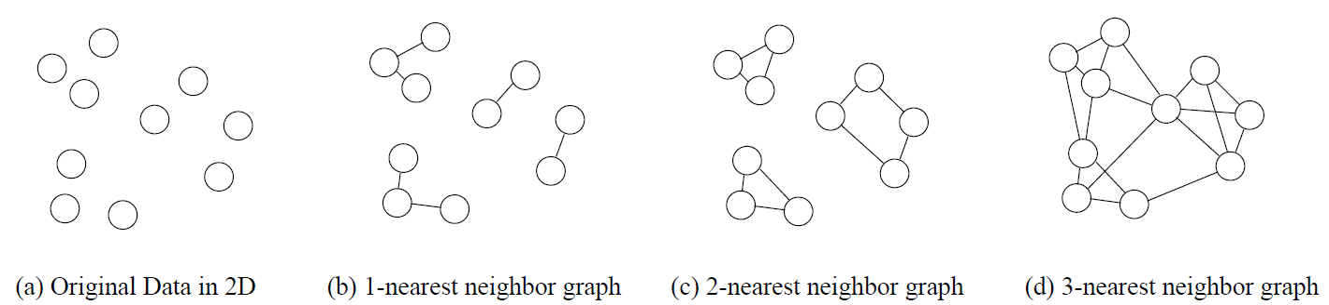
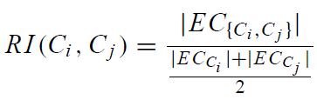
KNN Graphs & Interconnectivity
k-nearest graphs from an original data in 2D:
EC{Ci ,Cj } :The absolute inter-connectivity between Ci and Cj: the sum of the weight of the edges that connect vertices in Ci to vertices in Cj
Internal inter-connectivity of a cluster Ci : the size of its min-cut bisector ECCi (i.e., the weighted sum of edges that partition the graph into two roughly equal parts)
Relative Inter-connectivity (RI):
<number>

Slide 38
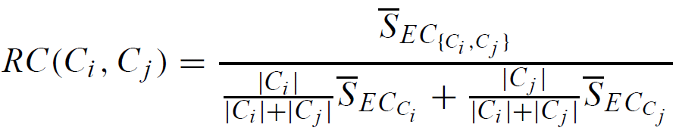



Relative Closeness & Merge of Sub-Clusters
Relative closeness between a pair of clusters Ci and Cj : the absolute closeness between Ci and Cj normalized w.r.t. the internal closeness of the two clusters Ci and Cj
  and are the average weights of the edges that belong in the min-cut bisector of clusters Ci and Cj , respectively, and is the average weight of the edges that connect vertices in Ci to vertices in Cj
_{Merge Sub-Clusters:}
  Merges only those pairs of clusters whose RI and RC are both above some user-specified thresholds
  Merge those maximizing the function that combines RI and RC
<number>

Slide 39
Overall Framework of CHAMELEON
Construct (K-NN)
Sparse Graph
Partition the Graph
Data Set
K-NN Graph
  P and q are connected if q is among the top k closest neighbors of p
Merge Partition
Relative interconnectivity: connectivity of c1 and c2 over internal connectivity
Relative closeness: closeness of c1 and c2 over internal closeness
Final Clusters
<number>
Notes:
<number>

Slide 40
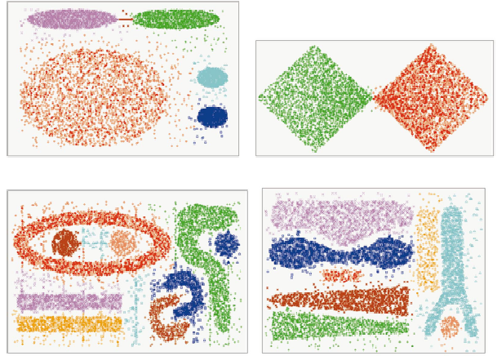
CHAMELEON (Clustering Complex Objects)
<number>
Notes:
<number>

Slide 41
Probabilistic Hierarchical Clustering
Algorithmic hierarchical clustering
  Nontrivial to choose a good distance measure
  Hard to handle missing attribute values
  Optimization goal not clear: heuristic, local search
Probabilistic hierarchical clustering
  Use probabilistic models to measure distances between clusters
  Generative model: Regard the set of data objects to be clustered as a sample of the underlying data generation mechanism to be analyzed
  Easy to understand, same efficiency as algorithmic agglomerative clustering method, can handle partially observed data
In practice, assume the generative models adopt common distribution functions, e.g., Gaussian distribution or Bernoulli distribution, governed by parameters
<number>

Slide 42
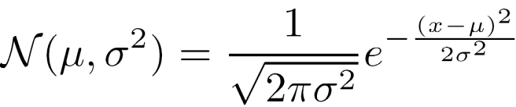
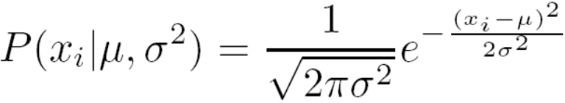

Generative Model
Given a set of 1-D points X = {x1, …, xn} for clustering analysis & assuming they are generated by a Gaussian distribution:
The probability that a point xi ∈ X is generated by the model
The likelihood that X is generated by the model:
The task of learning the generative model: find the parameters μ and σ^{2 such that}
the maximum likelihood
<number>

Slide 43
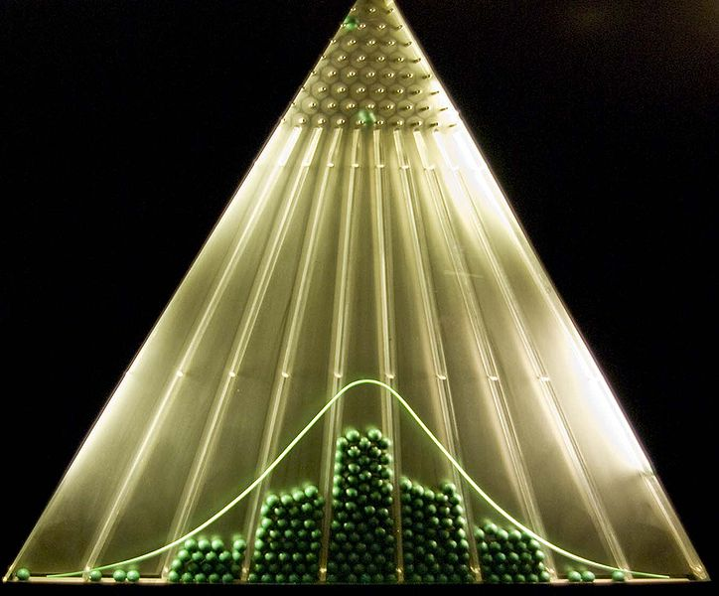
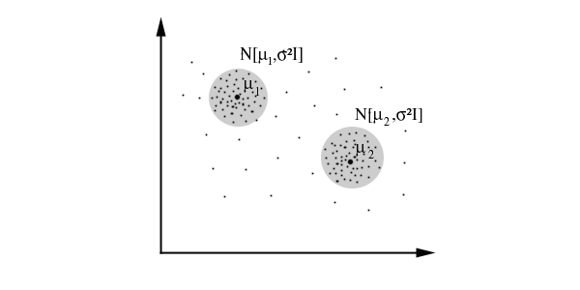
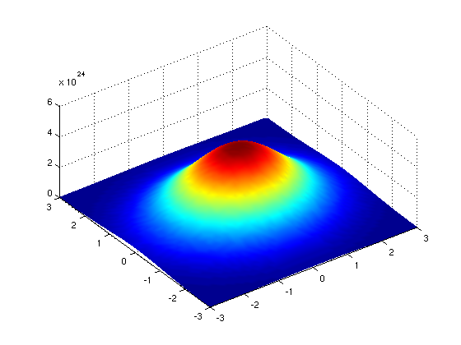
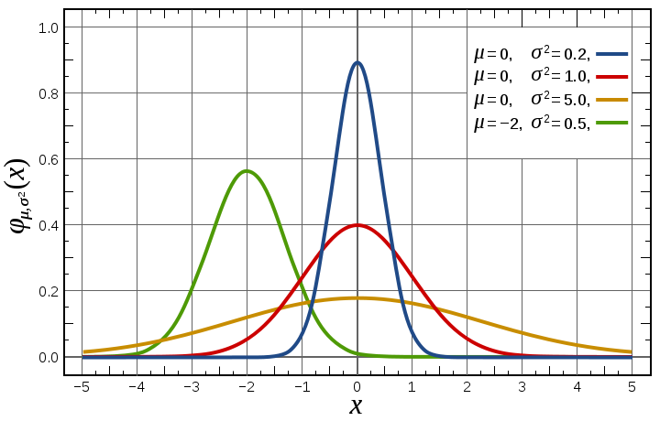
Gaussian Distribution
Bean machine: drop ball with pins
1-d Gaussian
2-d Gaussian
From wikipedia and http://home.dei.polimi.it
<number>

Slide 44

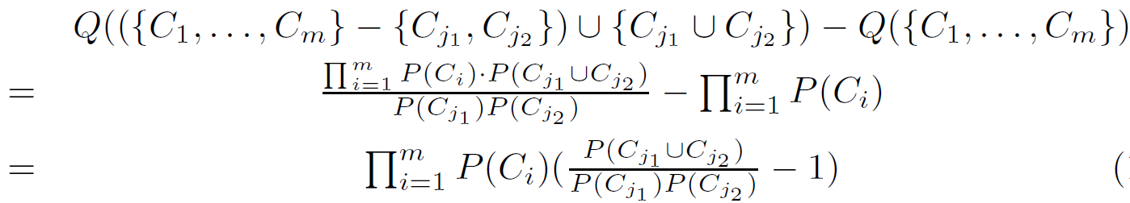
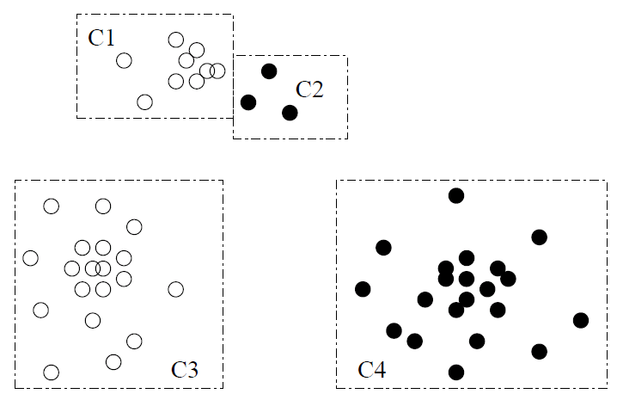

A Probabilistic Hierarchical Clustering Algorithm
For a set of objects partitioned into m clusters C1, . . . ,Cm, the quality can be measured by,
  where P() is the maximum likelihood
If we merge two clusters Cj1 and Cj2 into a cluster Cj1∪Cj2, then, the change in quality of the overall clustering is
Distance between clusters C1 and C2:
If dist(Ci, Cj) < 0, merge Ci and Cj
<number>

Slide 45
Chapter 10. Cluster Analysis: Basic Concepts and Methods
Cluster Analysis: Basic Concepts
Partitioning Methods
Hierarchical Methods
Density-Based Methods
Grid-Based Methods
Evaluation of Clustering
Summary
<number>
<number>
Notes:
<number>

Slide 46
Density-Based Clustering Methods
Clustering based on density (local cluster criterion), such as density-connected points
Major features:
  Discover clusters of arbitrary shape
  Handle noise
  One scan
  Need density parameters as termination condition
Several interesting studies:
  DBSCAN: Ester, et al. (KDD’96)
  OPTICS: Ankerst, et al (SIGMOD’99).
  DENCLUE: Hinneburg & D. Keim (KDD’98)
  CLIQUE: Agrawal, et al. (SIGMOD’98) (more grid-based)
<number>
Notes:
<number>

Slide 47
Density-Based Clustering: Basic Concepts
Two parameters:
  Eps: Maximum radius of the neighbourhood
  MinPts: Minimum number of points in an Eps-neighbourhood of that point
NEps(q): {p belongs to D | dist(p,q) ≤ Eps}
Directly density-reachable: A point p is directly density-reachable from a point q w.r.t. Eps, MinPts if
  _{p belongs to NEps(q)}
  _{core point condition:}
  _{|NEps (q)| ≥ MinPts}
p
MinPts = 5
Eps = 1 cm
q
<number>
Notes:
<number>

Slide 48
Density-Reachable and Density-Connected
Density-reachable:
  A point p is density-reachable from a point q w.r.t. Eps, MinPts if there is a chain of points p1, …, pn, p1 = q, pn = p such that pi+1 is directly density-reachable from pi
_{Density-connected}
  A point p is density-connected to a point q w.r.t. Eps, MinPts if there is a point o such that both, p and q are density-reachable from o w.r.t. Eps and MinPts
p
p₁
q
p
q
o
<number>
Notes:
<number>

Slide 49
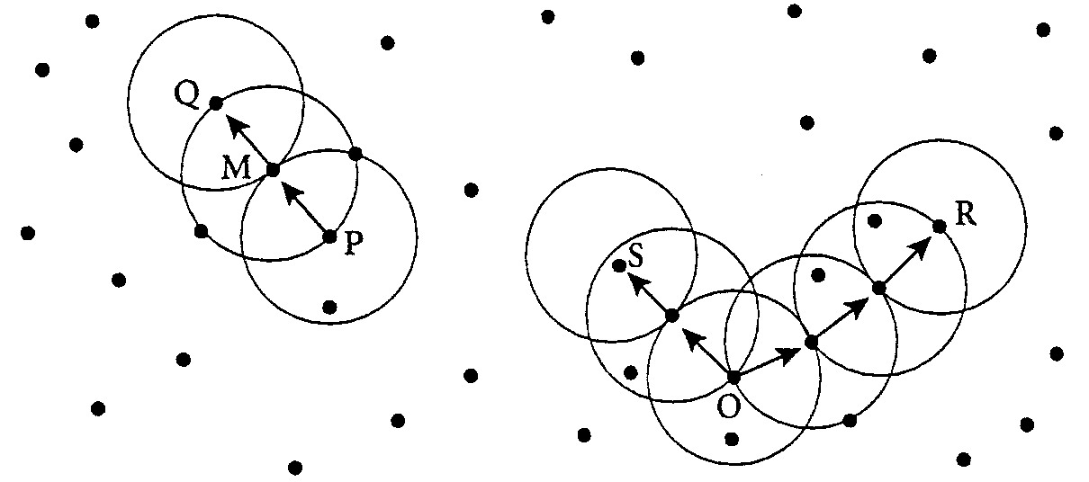
An Example
Of the labeled points, M, P, O, and R are core objects since each is in an ε-neighborhood containing at least three points.
Q is directly density-reachable from M. M is directly density-reachable from P and vice versa.
Q is (indirectly) density-reachable from P since Q is directly density-reachable from M and M is directly density-reachable from P. However, P is not density-reachable from Q since Q is not a core object.
Similarly, R and S are density-reachable from O and O is density-reachable from R.
O, R, and S are all density-connected.

Slide 50
Algorithm: DBSCAN: a density-based clustering algorithm.
Input:
D : a data set containing n objects,
ε : the radius parameter, and
MinPts: the neighborhood density threshold.
Output: A set of density-based clusters.
Method:
(1) mark all objects as unvisited;
(2) do
(3) randomly select an unvisited object p;
(4) mark p as visited;
(5) if the -neighborhood of p has at least MinPts objects
(6) create a new cluster C, and add p to C;
(7) let N be the set of objects in the -neighborhood of p;
(8) for each point p' in N
(9) if p' is unvisited
(10) mark p' as visited;
(11) if the -neighborhood of p' has at least MinPts points,
add those points to N ;

Slide 51
(12) if p' is not yet a member of any cluster, add p' to C;
(13) end for
(14)output C;
(15) else mark p as noise;
(16) until no object is unvisited;

Slide 52
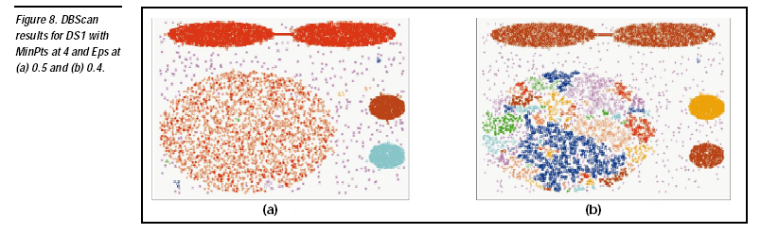

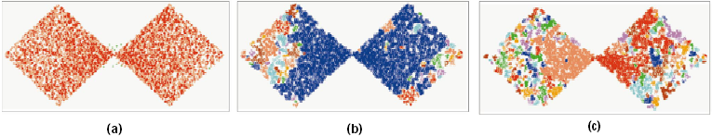
DBSCAN: Sensitive to Parameters
DBSCAN online Demo:
http://webdocs.cs.ualberta.ca/~yaling/Cluster/Applet/Code/Cluster.html
<number>
Notes:
<number>

Slide 53
OPTICS: A Cluster-Ordering Method (1999)
OPTICS: Ordering Points To Identify the Clustering Structure
  Ankerst, Breunig, Kriegel, and Sander (SIGMOD’99)
  Produces a special order of the database wrt its density-based clustering structure
  This cluster-ordering contains info equiv to the density-based clusterings corresponding to a broad range of parameter settings
  Good for both automatic and interactive cluster analysis, including finding intrinsic clustering structure
  Can be represented graphically or using visualization techniques
<number>
Notes:
<number>

Slide 54
OPTICS: Some Extension from DBSCAN
Index-based: k = # of dimensions, N: # of points
  Complexity: O(N*logN)
Core Distance of an object p: the smallest value ε such that the ε-neighborhood of p has at least MinPts objects
  Let Nε(p): ε-neighborhood of p, ε is a distance value
<number>
Notes:
<number>

Slide 55
Core Distance & Reachability Distance
The core-distance of an object p is the smallest value ε' such that the ε' -neighborhood of p has at least MinPts objects.
That is, is the minimum distance threshold that makes p a core object.
If p is not a core object with respect to and MinPts, the core-distance of p is undefined.
The reachability-distance to object p from q is the minimum radius value that makes
p density-reachable from q.
According to the definition of density-reachability, q has to be a core object and p must be in the neighborhood of q.
Therefore, the reachability-distance from q to p is max{core-distance(q), dist(p, q)}.
If q is not a core object with respect to and MinPts, the reachability-distance to p from q is undefined.

Slide 56
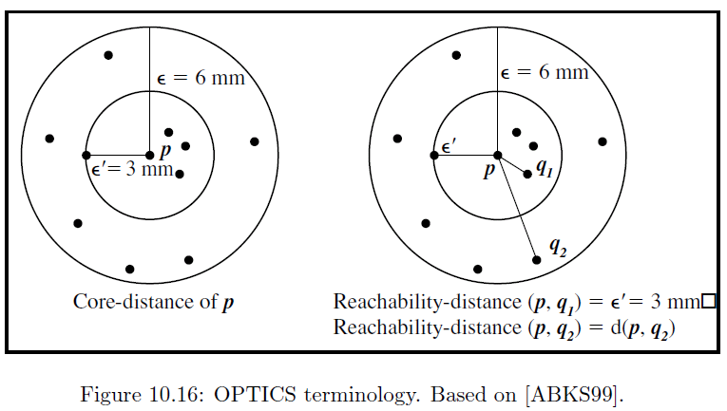
Core Distance & Reachability Distance
<number>

Slide 57
Reachability-distance
undefined
‘
Cluster-order
of the objects

Slide 58
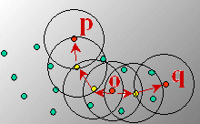
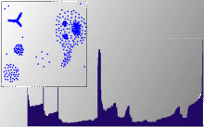
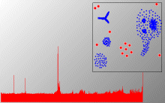
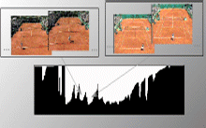
Density-Based Clustering: OPTICS & Applications
demo: http://www.dbs.informatik.uni-muenchen.de/Forschung/KDD/Clustering/OPTICS/Demo
<number>
Notes:
<number>

Slide 59
DENCLUE: Using Statistical Density Functions
DENsity-based CLUstEring by Hinneburg & Keim (KDD’98)
Using statistical density functions:
Major features
  Solid mathematical foundation
  Good for data sets with large amounts of noise
  Allows a compact mathematical description of arbitrarily shaped clusters in high-dimensional data sets
  Significant faster than existing algorithm (e.g., DBSCAN)
  But needs a large number of parameters
total influence on x
influence of y on x
gradient of x in the direction of x_{i}
<number>
Notes:
<number>

Slide 60
Denclue: Technical Essence
Uses grid cells but only keeps information about grid cells that do actually contain data points and manages these cells in a tree-based access structure
Influence function: describes the impact of a data point within its neighborhood
Overall density of the data space can be calculated as the sum of the influence function of all data points
Clusters can be determined mathematically by identifying density attractors
Density attractors are local maximal of the overall density function
Center defined clusters: assign to each density attractor the points density attracted to it
Arbitrary shaped cluster: merge density attractors that are connected through paths of high density (> threshold)
<number>
Notes:
<number>

Slide 61
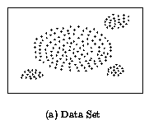
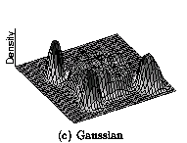
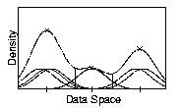
Density Attractor
<number>
Notes:
<number>

Slide 62
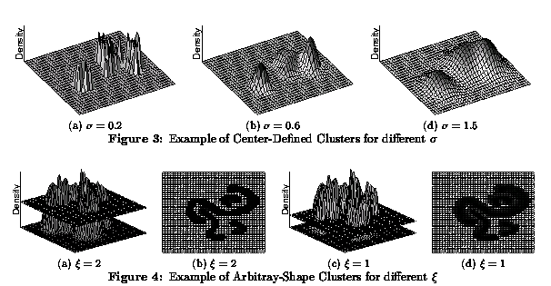
Center-Defined and Arbitrary
<number>
Notes:
<number>

Slide 63
Chapter 10. Cluster Analysis: Basic Concepts and Methods
Cluster Analysis: Basic Concepts
Partitioning Methods
Hierarchical Methods
Density-Based Methods
Grid-Based Methods
Evaluation of Clustering
Summary
<number>
<number>
Notes:
<number>

Slide 64
Grid-Based Clustering Method
Using multi-resolution grid data structure
Several interesting methods
  STING (a STatistical INformation Grid approach) by Wang, Yang and Muntz (1997)
  CLIQUE: Agrawal, et al. (SIGMOD’98)
    Both grid-based and subspace clustering
  WaveCluster by Sheikholeslami, Chatterjee, and Zhang (VLDB’98)
    A multi-resolution clustering approach using wavelet method
<number>
Notes:
<number>

Slide 65
STING: A Statistical Information Grid Approach
Wang, Yang and Muntz (VLDB’97)
The spatial area is divided into rectangular cells
There are several levels of cells corresponding to different levels of resolution
<number>
Notes:
<number>

Slide 66
The STING Clustering Method
Each cell at a high level is partitioned into a number of smaller cells in the next lower level
Statistical info of each cell is calculated and stored beforehand and is used to answer queries
Parameters of higher level cells can be easily calculated from parameters of lower level cell
  count, mean, s, min, max
  type of distribution—normal, uniform, etc.
Use a top-down approach to answer spatial data queries
Start from a pre-selected layer—typically with a small number of cells
For each cell in the current level compute the confidence interval
<number>
Notes:
<number>

Slide 67
STING Algorithm and Its Analysis
Remove the irrelevant cells from further consideration
When finish examining the current layer, proceed to the next lower level
Repeat this process until the bottom layer is reached
Advantages:
  Query-independent, easy to parallelize, incremental update
  O(K), where K is the number of grid cells at the lowest level
Disadvantages:
  All the cluster boundaries are either horizontal or vertical, and no diagonal boundary is detected
<number>
Notes:
<number>

Slide 68
CLIQUE (Clustering In QUEst)
Agrawal, Gehrke, Gunopulos, Raghavan (SIGMOD’98)
Automatically identifying subspaces of a high dimensional data space that allow better clustering than original space
CLIQUE can be considered as both density-based and grid-based
  It partitions each dimension into the same number of equal length interval
  It partitions an m-dimensional data space into non-overlapping rectangular units
  A unit is dense if the fraction of total data points contained in the unit exceeds the input model parameter
  A cluster is a maximal set of connected dense units within a subspace
<number>
Notes:
<number>

Slide 69
CLIQUE: The Major Steps
Partition the data space and find the number of points that lie inside each cell of the partition.
Identify the subspaces that contain clusters using the Apriori principle
Identify clusters
  Determine dense units in all subspaces of interests
  Determine connected dense units in all subspaces of interests.
Generate minimal description for the clusters
  Determine maximal regions that cover a cluster of connected dense units for each cluster
  Determination of minimal cover for each cluster
<number>
Notes:
<number>

Slide 70
Salary (10,000)
Vacation(week)
7
7
6
6
5
5
4
4
3
3
2
2
1
1
0
age
0
age
20
30
40
50
60
20
30
40
50
60
τ = 3
Vacation
Salary
30
50
age
<number>
Notes:
<number>

Slide 71
Strength and Weakness of CLIQUE
Strength
  automatically finds subspaces of the highest dimensionality such that high density clusters exist in those subspaces
  insensitive to the order of records in input and does not presume some canonical data distribution
  scales linearly with the size of input and has good scalability as the number of dimensions in the data increases
Weakness
  The accuracy of the clustering result may be degraded at the expense of simplicity of the method
<number>
Notes:
<number>

Slide 72
Chapter 10. Cluster Analysis: Basic Concepts and Methods
Cluster Analysis: Basic Concepts
Partitioning Methods
Hierarchical Methods
Density-Based Methods
Grid-Based Methods
Evaluation of Clustering
Summary
<number>
<number>
Notes:
<number>

Slide 73
Determine the Number of Clusters
Empirical method
  # of clusters: k ≈√n/2 for a dataset of n points, e.g., n = 200, k = 10
Elbow method
  Use the turning point in the curve of sum of within cluster variance w.r.t the # of clusters
Cross validation method
  Divide a given data set into m parts
  Use m – 1 parts to obtain a clustering model
  Use the remaining part to test the quality of the clustering
    E.g., For each point in the test set, find the closest centroid, and use the sum of squared distance between all points in the test set and the closest centroids to measure how well the model fits the test set
  For any k > 0, repeat it m times, compare the overall quality measure w.r.t. different k’s, and find # of clusters that fits the data the best
<number>

Slide 74
Measuring Clustering Quality
3 kinds of measures: External, internal and relative
External: supervised, employ criteria not inherent to the dataset
  Compare a clustering against prior or expert-specified knowledge (i.e., the ground truth) using certain clustering quality measure
Internal: unsupervised, criteria derived from data itself
  Evaluate the goodness of a clustering by considering how well the clusters are separated, and how compact the clusters are, e.g., Silhouette coefficient
Relative: directly compare different clusterings, usually those obtained via different parameter settings for the same algorithm
<number>

Slide 75
Measuring Clustering Quality: External Methods
Clustering quality measure: Q(C, T), for a clustering C given the ground truth T
Q is good if it satisfies the following 4 essential criteria
  Cluster homogeneity: the purer, the better
  Cluster completeness: should assign objects belong to the same category in the ground truth to the same cluster
  Rag bag: putting a heterogeneous object into a pure cluster should be penalized more than putting it into a rag bag (i.e., “miscellaneous” or “other” category)
  Small cluster preservation: splitting a small category into pieces is more harmful than splitting a large category into pieces
<number>

Slide 76
Some Commonly Used External Measures
Matching-based measures
  Purity, maximum matching, F-measure
Entropy-Based Measures
  Conditional entropy, normalized mutual information (NMI), variation of information
Pair-wise measures
  Four possibilities: True positive (TP), FN, FP, TN
  Jaccard coefficient, Rand statistic, Fowlkes-Mallow measure
Correlation measures
  Discretized Huber static, normalized discretized Huber static
Ground truth partitioning T₁
T₂
Cluster C₁
Cluster C₂
<number>

Slide 77
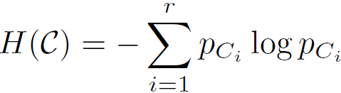

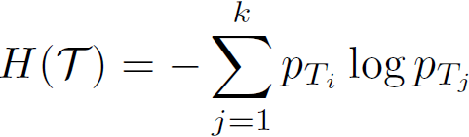
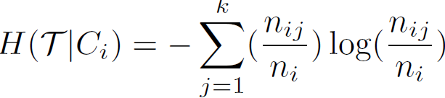
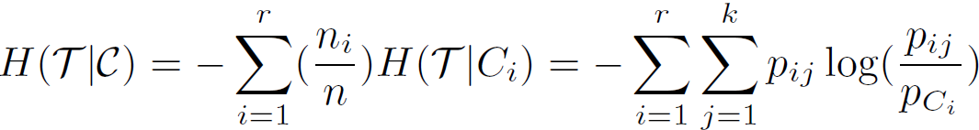

Entropy-Based Measure (I): Conditional Entropy
Entropy of clustering C:
Entropy of partitioning T:
Entropy of T w.r.t. cluster C_{i:}
_{Conditional entropy of T}
  _{w.r.t. clustering C:}
  The more a cluster’s members are split into different partitions, the higher the conditional entropy
  For a perfect clustering, the conditional entropy value is 0, where the worst possible conditional entropy value is log k
<number>

Slide 78
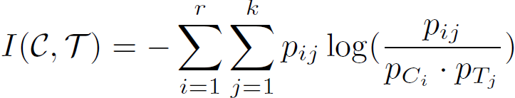

Entropy-Based Measure (II): Normalized mutual information (NMI)
Mutual information: quantify the amount of shared info between the clustering C and partitioning T:
  It measures the dependency between the observed joint probability pij of C and T, and the expected joint probability pCi * pTj under the independence assumption
  When C and T are independent, pij = pCi * pTj, I(C, T) = 0. However, there is no upper bound on the mutual information
Normalized mutual information (NMI)
    Value range of NMI: [0,1]. Value close to 1 indicates a good clustering
<number>

Slide 79
Chapter 10. Cluster Analysis: Basic Concepts and Methods
Cluster Analysis: Basic Concepts
Partitioning Methods
Hierarchical Methods
Density-Based Methods
Grid-Based Methods
Evaluation of Clustering
Summary
<number>
<number>
Notes:
<number>

Slide 80
Summary
Cluster analysis groups objects based on their similarity and has wide applications
Measure of similarity can be computed for various types of data
Clustering algorithms can be categorized into partitioning methods, hierarchical methods, density-based methods, grid-based methods, and model-based methods
K-means and K-medoids algorithms are popular partitioning-based clustering algorithms
Birch and Chameleon are interesting hierarchical clustering algorithms, and there are also probabilistic hierarchical clustering algorithms
DBSCAN, OPTICS, and DENCLU are interesting density-based algorithms
STING and CLIQUE are grid-based methods, where CLIQUE is also a subspace clustering algorithm
Quality of clustering results can be evaluated in various ways
<number>
Notes:
<number>

Slide 81
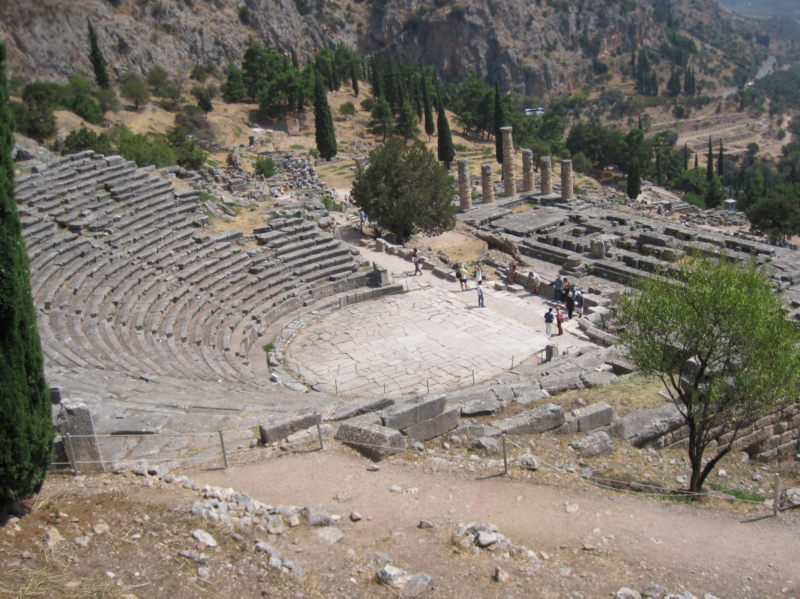
<number>

Slide 82

<number>

Slide 83
CS512-Spring 2011: An Introduction
Coverage
  Cluster Analysis: Chapter 11
  Outlier Detection: Chapter 12
  Mining Sequence Data: BK2: Chapter 8
  Mining Graphs Data: BK2: Chapter 9
  Social and Information Network Analysis
    BK2: Chapter 9
    Partial coverage: Mark Newman: “Networks: An Introduction”, Oxford U., 2010
    Scattered coverage: Easley and Kleinberg, “Networks, Crowds, and Markets: Reasoning About a Highly Connected World”, Cambridge U., 2010
    Recent research papers
  Mining Data Streams: BK2: Chapter 8
Requirements
  One research project
  One class presentation (15 minutes)
  Two homeworks (no programming assignment)
  Two midterm exams (no final exam)
<number>
Notes:
<number>
<number>

Slide 84
References (1)
R. Agrawal, J. Gehrke, D. Gunopulos, and P. Raghavan. Automatic subspace clustering of high dimensional data for data mining applications. SIGMOD'98
M. R. Anderberg. Cluster Analysis for Applications. Academic Press, 1973.
M. Ankerst, M. Breunig, H.-P. Kriegel, and J. Sander. Optics: Ordering points to identify the clustering structure, SIGMOD’99.
Beil F., Ester M., Xu X.: "Frequent Term-Based Text Clustering", KDD'02
M. M. Breunig, H.-P. Kriegel, R. Ng, J. Sander. LOF: Identifying Density-Based Local Outliers. SIGMOD 2000.
M. Ester, H.-P. Kriegel, J. Sander, and X. Xu. A density-based algorithm for discovering clusters in large spatial databases. KDD'96.
M. Ester, H.-P. Kriegel, and X. Xu. Knowledge discovery in large spatial databases: Focusing techniques for efficient class identification. SSD'95.
D. Fisher. Knowledge acquisition via incremental conceptual clustering. Machine Learning, 2:139-172, 1987.
D. Gibson, J. Kleinberg, and P. Raghavan. Clustering categorical data: An approach based on dynamic systems. VLDB’98.
V. Ganti, J. Gehrke, R. Ramakrishan. CACTUS Clustering Categorical Data Using Summaries. KDD'99.
<number>
Notes:
<number>

Slide 85
References (2)
D. Gibson, J. Kleinberg, and P. Raghavan. Clustering categorical data: An approach based on dynamic systems. In Proc. VLDB’98.
S. Guha, R. Rastogi, and K. Shim. Cure: An efficient clustering algorithm for large databases. SIGMOD'98.
S. Guha, R. Rastogi, and K. Shim. ROCK: A robust clustering algorithm for categorical attributes. In ICDE'99, pp. 512-521, Sydney, Australia, March 1999.
A. Hinneburg, D.l A. Keim: An Efficient Approach to Clustering in Large Multimedia Databases with Noise. KDD’98.
A. K. Jain and R. C. Dubes. Algorithms for Clustering Data. Printice Hall, 1988.
G. Karypis, E.-H. Han, and V. Kumar. CHAMELEON: A Hierarchical Clustering Algorithm Using Dynamic Modeling. COMPUTER, 32(8): 68-75, 1999.
L. Kaufman and P. J. Rousseeuw. Finding Groups in Data: an Introduction to Cluster Analysis. John Wiley & Sons, 1990.
E. Knorr and R. Ng. Algorithms for mining distance-based outliers in large datasets. VLDB’98.
<number>
Notes:
<number>

Slide 86
References (3)
G. J. McLachlan and K.E. Bkasford. Mixture Models: Inference and Applications to Clustering. John Wiley and Sons, 1988.
R. Ng and J. Han. Efficient and effective clustering method for spatial data mining. VLDB'94.
L. Parsons, E. Haque and H. Liu, Subspace Clustering for High Dimensional Data: A Review, SIGKDD Explorations, 6(1), June 2004
E. Schikuta. Grid clustering: An efficient hierarchical clustering method for very large data sets. Proc. 1996 Int. Conf. on Pattern Recognition,.
G. Sheikholeslami, S. Chatterjee, and A. Zhang. WaveCluster: A multi-resolution clustering approach for very large spatial databases. VLDB’98.
A. K. H. Tung, J. Han, L. V. S. Lakshmanan, and R. T. Ng. Constraint-Based Clustering in Large Databases, ICDT'01.
A. K. H. Tung, J. Hou, and J. Han. Spatial Clustering in the Presence of Obstacles, ICDE'01
H. Wang, W. Wang, J. Yang, and P.S. Yu. Clustering by pattern similarity in large data sets, SIGMOD’ 02.
W. Wang, Yang, R. Muntz, STING: A Statistical Information grid Approach to Spatial Data Mining, VLDB’97.
T. Zhang, R. Ramakrishnan, and M. Livny. BIRCH : An efficient data clustering method for very large databases. SIGMOD'96.
Xiaoxin Yin, Jiawei Han, and Philip Yu, “LinkClus: Efficient Clustering via Heterogeneous Semantic Links”, in Proc. 2006 Int. Conf. on Very Large Data Bases (VLDB'06), Seoul, Korea, Sept. 2006.
<number>
Notes:
<number>

Slide 87
Chapter 10. Cluster Analysis: Basic Concepts and Methods
Cluster Analysis: Basic Concepts
  What Is Cluster Analysis?
  What is Good Clustering? Measuring the Quality of Clustering
  Major categories of clustering methods
Clustering structures
  Calculating Distance between Clusters
Partitioning Methods
  k-Means: A Classical Partitioning Method
  Alternative Methods: k-Medoids, k-Median, and its Variations
Hierarchical Methods
  Agglomerative and Divisive Hierarchical Clustering
  BIRCH: A Hierarchical, Micro-Clustering Approach
  Chameleon: A Hierarchical Clustering Algorithm Using Dynamic Modeling
Density-Based Methods
  DBSCAN and OPTICS: Density-Based Clustering Based on Connected Regions
  DENCLUE: Clustering Based on Density Distribution Functions
Link-Based Cluster Analysis
  SimRank: Exploring Links in Cluster Analysis
  LinkClus: Scalability in Link-Based Cluster Analysis
Grid-Based Methods
  STING: STatistical INformation Grid
  WaveCluster: Clustering Using Wavelet Transformation
  CLIQUE: A Dimension-Growth Subspace Clustering Method
Summary
<number>
<number>
Notes:
<number>

Slide 88
Slides unused in class
<number>
Notes:
<number>

Slide 89
A Typical K-Medoids Algorithm (PAM)
Total Cost = 20
10
9
8
Arbitrary choose k object as initial medoids
Assign each remaining object to nearest medoids
7
6
5
4
3
2
1
0
0
1
2
3
4
5
6
7
8
9
10
K=2
Randomly select a nonmedoid object,O_{ramdom}
Total Cost = 26
Do loop
Until no change
10
10
9
Compute total cost of swapping
9
Swapping O and O_{ramdom}
_{If quality is improved.}
8
8
7
7
6
6
5
5
4
4
3
3
2
2
1
1
0
0
1
2
3
4
5
6
7
8
9
10
0
0
1
2
3
4
5
6
7
8
9
10
<number>
Notes:
<number>

Slide 90
PAM (Partitioning Around Medoids) (1987)
PAM (Kaufman and Rousseeuw, 1987), built in Splus
Use real object to represent the cluster
  Select k representative objects arbitrarily
  For each pair of non-selected object h and selected object i, calculate the total swapping cost TC_{ih}
  _{For each pair of i and h,}
    If TCih < 0, i is replaced by h
    Then assign each non-selected object to the most similar representative object
  repeat steps 2-3 until there is no change
<number>
Notes:
<number>

Slide 91
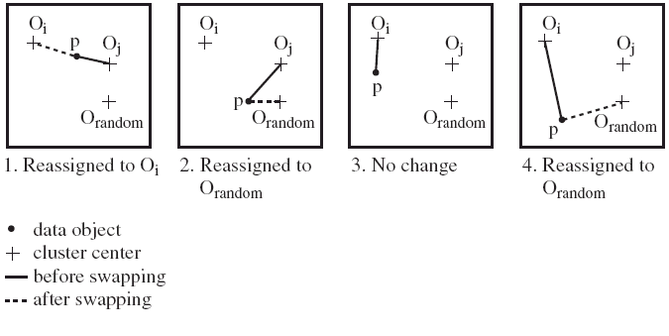
PAM Clustering: Finding the Best Cluster Center
Case 1: p currently belongs to oj. If oj is replaced by orandom as a representative object and p is the closest to one of the other representative object oi, then p is reassigned to oi
<number>
Notes:
<number>

Slide 92
What Is the Problem with PAM?
Pam is more robust than k-means in the presence of noise and outliers because a medoid is less influenced by outliers or other extreme values than a mean
Pam works efficiently for small data sets but does not scale well for large data sets.
  O(k(n-k)^{2 ) for each iteration}
where n is # of data,k is # of clusters
^{Sampling-based method}
CLARA(Clustering LARge Applications)
<number>
Notes:
<number>

Slide 93
CLARA (Clustering Large Applications) (1990)
CLARA (Kaufmann and Rousseeuw in 1990)
  Built in statistical analysis packages, such as SPlus
  It draws multiple samples of the data set, applies PAM on each sample, and gives the best clustering as the output
Strength: deals with larger data sets than PAM
Weakness:
  Efficiency depends on the sample size
  A good clustering based on samples will not necessarily represent a good clustering of the whole data set if the sample is biased
<number>
Notes:
<number>

Slide 94
CLARANS (“Randomized” CLARA) (1994)
CLARANS (A Clustering Algorithm based on Randomized Search) (Ng and Han’94)
  Draws sample of neighbors dynamically
  The clustering process can be presented as searching a graph where every node is a potential solution, that is, a set of k medoids
  If the local optimum is found, it starts with new randomly selected node in search for a new local optimum
Advantages: More efficient and scalable than both PAM and CLARA
Further improvement: Focusing techniques and spatial access structures (Ester et al.’95)
<number>
Notes:
<number>

Slide 95
ROCK: Clustering Categorical Data
ROCK: RObust Clustering using linKs
  S. Guha, R. Rastogi & K. Shim, ICDE’99
Major ideas
  Use links to measure similarity/proximity
  Not distance-based
Algorithm: sampling-based clustering
  Draw random sample
  Cluster with links
  Label data in disk
Experiments
  Congressional voting, mushroom data
<number>
Notes:
<number>

Slide 96
Similarity Measure in ROCK
Traditional measures for categorical data may not work well, e.g., Jaccard coefficient
Example: Two groups (clusters) of transactions
  C1. <a, b, c, d, e>: {a, b, c}, {a, b, d}, {a, b, e}, {a, c, d}, {a, c, e}, {a, d, e}, {b, c, d}, {b, c, e}, {b, d, e}, {c, d, e}
  C2. <a, b, f, g>: {a, b, f}, {a, b, g}, {a, f, g}, {b, f, g}
Jaccard co-efficient may lead to wrong clustering result
  C1: 0.2 ({a, b, c}, {b, d, e}} to 0.5 ({a, b, c}, {a, b, d})
  C1 & C2: could be as high as 0.5 ({a, b, c}, {a, b, f})
Jaccard co-efficient-based similarity function:
  Ex. Let T1 = {a, b, c}, T2 = {c, d, e}
<number>
Notes:
<number>

Slide 97
Link Measure in ROCK
Clusters
  C1:<a, b, c, d, e>: {a, b, c}, {a, b, d}, {a, b, e}, {a, c, d}, {a, c, e}, {a, d, e}, {b, c, d}, {b, c, e}, {b, d, e}, {c, d, e}
  C2: <a, b, f, g>: {a, b, f}, {a, b, g}, {a, f, g}, {b, f, g}
_{Neighbors}
  Two transactions are neighbors if sim(T1,T2) > threshold
  Let T1 = {a, b, c}, T2 = {c, d, e}, T3 = {a, b, f}
    T1 connected to: {a,b,d}, {a,b,e}, {a,c,d}, {a,c,e}, {b,c,d}, {b,c,e}, {a,b,f}, {a,b,g}
    T2 connected to: {a,c,d}, {a,c,e}, {a,d,e}, {b,c,e}, {b,d,e}, {b,c,d}
    T3 connected to: {a,b,c}, {a,b,d}, {a,b,e}, {a,b,g}, {a,f,g}, {b,f,g}
_{Link Similarity}
  Link similarity between two transactions is the # of common neighbors
  link(T1, T2) = 4, since they have 4 common neighbors
    {a, c, d}, {a, c, e}, {b, c, d}, {b, c, e}
  link(T1, T3) = 3, since they have 3 common neighbors
    {a, b, d}, {a, b, e}, {a, b, g}
<number>
Notes:
<number>

Slide 98
Rock Algorithm
Method
  Compute similarity matrix
    Use link similarity
  Run agglomerative hierarchical clustering
  When the data set is big
    Get sample of transactions
    Cluster sample
Problems:
  Guarantee cluster interconnectivity
    any two transactions in a cluster are very well connected
  Ignores information about closeness of two clusters
    two separate clusters may still be quite connected
<number>
Notes:
<number>

Slide 99
Measuring Clustering Quality: External Methods
Clustering quality measure: Q(C, Cg), for a clustering C given the ground truth Cg.
Q is good if it satisfies the following 4 essential criteria
  Cluster homogeneity: the purer, the better
  Cluster completeness: should assign objects belong to the same category in the ground truth to the same cluster
  Rag bag: putting a heterogeneous object into a pure cluster should be penalized more than putting it into a rag bag (i.e., “miscellaneous” or “other” category)
  Small cluster preservation: splitting a small category into pieces is more harmful than splitting a large category into pieces
<number>

Slide 100
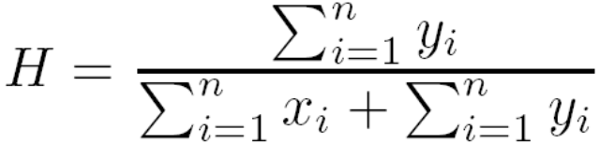
Assessing Clustering Tendency
Assess if non-random structure exists in the data by measuring the probability that the data is generated by a uniform data distribution
Test spatial randomness by statistic test: Hopkins Static
  Given a dataset D regarded as a sample of a random variable o, determine how far away o is from being uniformly distributed in the data space
  Sample n points, p1, …, pn, uniformly from D. For each pi, find its nearest neighbor in D: xi = min{dist (pi, v)} where v in D
  Sample n points, q1, …, qn, uniformly from D. For each qi, find its nearest neighbor in D – {qi}: yi = min{dist (qi, v)} where v in D and v ≠ qi
  Calculate the Hopkins Statistic:
  If D is uniformly distributed, ∑ xi and ∑ yi will be close to each other and H is close to 0.5. If D is clustered, H is close to 1
<number>

